Slide 1







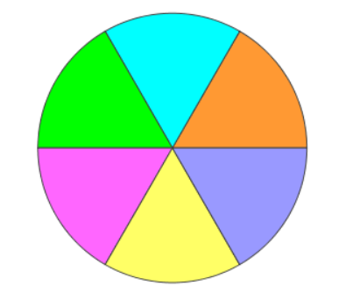

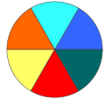
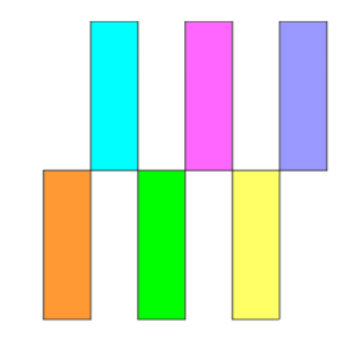

Legend
Pathway
Or
Ontology
Up Reg
Denotes non-regulated annotations
Denotes up-regulated annotations
Down Reg
Denotes down-regulated annotations
Gene
Name
Denotes proteins with PTM sites
Gene
Name
Denotes non-regulated proteins
PTM
Site
Denotes non-regulated PTM sites
Up
Reg
Denotes up-regulated query proteins
Up
Reg
Denotes up-regulated PTM sites
Down
Reg
Denotes down-regulated proteins
Down
Reg
Denotes down-regulated PTM sites
Sig
Gene
Denotes statistically significant proteins
Sig
Site
Denotes significantly expressed PTM sites
PTM**Site
Gene**
Name
Denotes ambiguous protein identity
Denotes ambiguous PTM site identity
Denotes labels in multi-fc analysis
Denotes labels in categorical analysis
Gene
Name
Denotes external interactor proteins
Denotes interaction edges

